Slide 1
Lecture 13
Tree

Slide 2
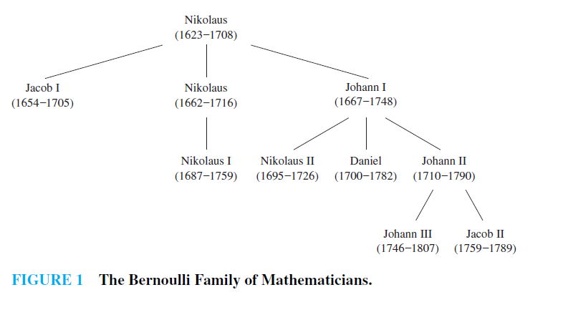
Introduction
A tree is a connected undirected graph with no simple circuits.
The family tree of the male members of the Bernoulli family of Swiss mathematicians is shown in Figure 1. The undirected graph representing a family tree is an example of a tree.

Slide 3
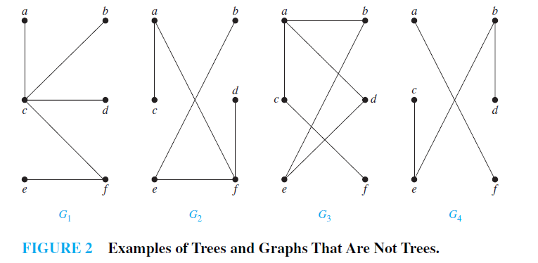
Continue
Because a tree cannot have a simple circuit, a tree cannot contain multiple edges or loops. Therefore any tree must be a simple graph.
Example
Which of the graphs shown in Figure 2 are trees?

Slide 4
Solution
G₁ and G₂ are trees, because both are connected graphs with no simple circuits. G₃ is not a tree because e, b, a, d, e is a simple circuit in this graph. Finally, G₄ is not a tree because it is not connected.

Slide 5
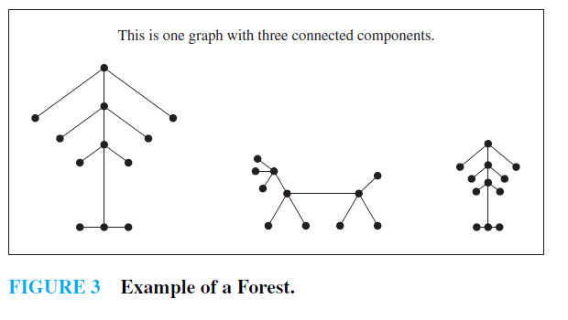
Forest
Graphs containing no simple circuits that are not necessarily connected are called forests and have the property that each of their connected components is a tree. Figure 3 displays a forest.

Slide 6
Theorem
An undirected graph is a tree if and only if there is a unique simple path between any two of its vertices.
Rooted Tree
A rooted tree is a tree in which one vertex has been designated as the root and every edge is directed away from the root.

Slide 7
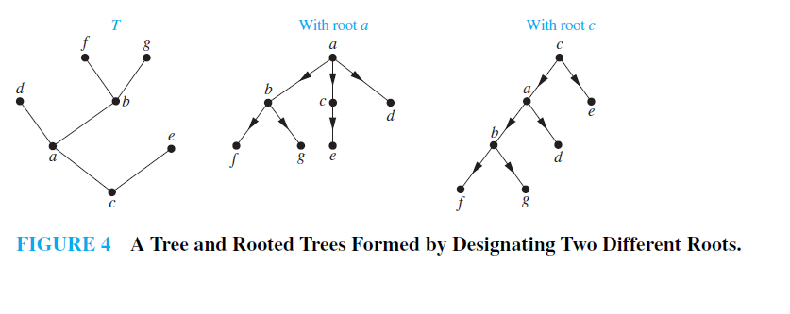
Rooted Tree-Continue
We can change an unrooted tree into a rooted tree by choosing any vertex as the root. Note that different choices of the root produce different rooted trees.

Slide 8
The terminology for trees
The terminology for trees has botanical and genealogical origins. Suppose that T is a rooted tree.
If v is a vertex in T other than the root, the parent of v is the unique vertex u such that there is a directed edge from u to v .
When u is the parent of v, v is called a child of u.
Vertices with the same parent are called siblings.
The ancestors of a vertex other than the root are the vertices in the path from the root to this vertex, excluding the vertex itself and including the root (that is, its parent, its parent’s parent, and so on, until the root is reached).

Slide 9
The terminology for trees-Continue
The descendants of a vertex v are those vertices that have v as an ancestor.
A vertex of a rooted tree is called a leaf if it has no children.
Vertices that have children are called internal vertices.
The root is an internal vertex unless it is the only vertex in the graph, in which case it is a leaf.
If a is a vertex in a tree, the subtree with a as its root is the subgraph of the tree consisting of a and its descendants and all edges incident to these descendants.

Slide 10
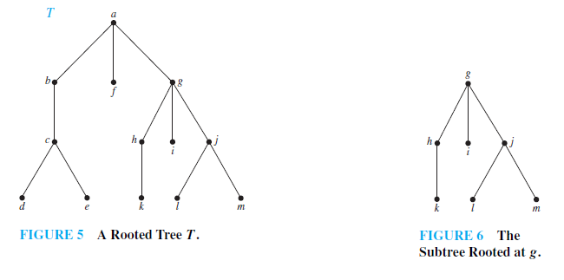
Example
In the rooted tree T (with root a) shown in Figure 5, find the parent of c, the children of g, the siblings of h, all ancestors of e, all descendants of b, all internal vertices, and all leaves. What is the subtree rooted at g?

Slide 11
Solution
The parent of c is b.
The children of g are h, i, and j . The siblings of h are i and j .
The ancestors of e are c, b, and a. The descendants of b are c, d, and e.
The internal vertices are a, b, c, g, h, and j .
The leaves are d, e, f , i, k, l, and m.
The subtree rooted at g is shown in Figure 6.

Slide 12
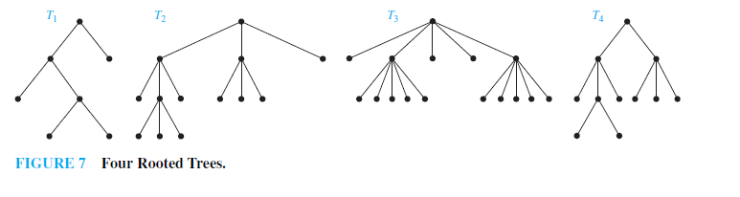
M-ary Tree
A rooted tree is called an m-ary tree if every internal vertex has no more than m children.
The tree is called a full m-ary tree if every internal vertex has exactly m children.
An m-ary tree with m = 2 is called a binary tree.
Example
Are the rooted trees in Figure 7 full m-ary trees for some positive integer m?

Slide 13
Solution
T₁ is a full binary tree because each of its internal vertices has two children.
T₂ is a full 3-ary tree because each of its internal vertices has three children.
In T₃ each internal vertex has five children, so T3 is a full 5-ary tree.
T₄ is not a full m-ary tree for any m because some of its internal vertices have two children and others have three children.

Slide 14
Ordered Rooted Trees
An ordered rooted tree is a rooted tree where the children of each internal vertex are ordered. Ordered rooted trees are drawn so that the children of each internal vertex are shown in order from left to right.
In an ordered binary tree (usually called just a binary tree), if an internal vertex has two children, the first child is called the left child and the second child is called the right child.
The tree rooted at the left child of a vertex is called the left subtree of this vertex, and the tree rooted at the right child of a vertex is called the right subtree of the vertex.

Slide 15
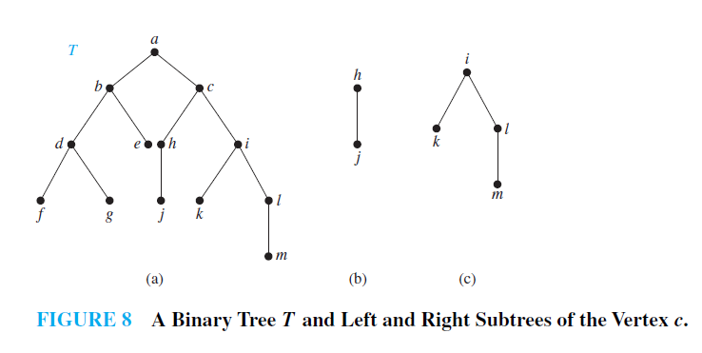
Example
What are the left and right children of d in the binary tree T shown in Figure 8(a) ? What are the left and right subtrees of c?
Solution: The left child of d is f and the right child is g. We show the left and right subtrees of c in Figures 8(b) and 8(c), respectively.

Slide 16
Definition
The level of a vertex v in a rooted tree is the length of the unique path from the root to this vertex. The level of the root is defined to be zero.
The height of a rooted tree is the maximum of the levels of vertices. In other words, the height of a rooted tree is the length of the longest path from the root to any vertex.
A rooted m-ary tree of height h is balanced if all leaves are at levels h or h − 1.

Slide 17
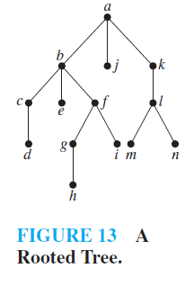
Example
Find the level of each vertex in the rooted tree shown in Figure 13. What is the height of this tree?
Solution
The root a is at level 0. Vertices b, j , and k are at level 1. Vertices c, e, f , and l are at
level 2.Vertices d, g, i, m, and n are at level 3. Finally, vertex h is at level 4. Because the largest level of any vertex is 4, this tree has height 4.

Slide 18
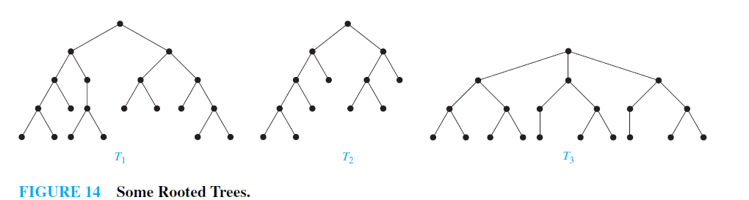
Example
Which of the rooted trees shown in Figure 14 are balanced?
Solution
T₁ is balanced, because all its leaves are at levels 3 and 4. However, T₂ is not balanced, because it has leaves at levels 2, 3, and 4. Finally, T₃ is balanced, because all its leaves are at level 3.

Slide 19
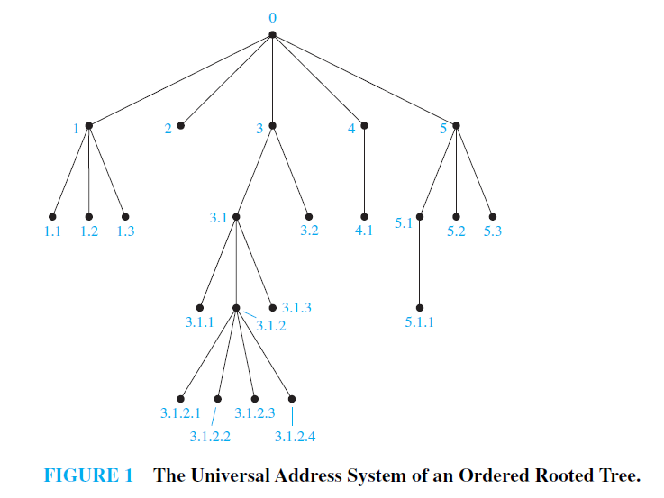
Example
Procedures for traversing all vertices of an ordered rooted tree rely on the orderings of children. To produce this ordering, we must first label all the vertices. We do this recursively:
Label the root with the integer 0. Then label its k children (at level 1) from left to right with 1, 2, 3, . . . , k.
For each vertex v at level n with label A, label its k_{v} children, as they are drawn from left to right, with A.1,A.2, . . . , A.k_{v}.

Slide 20
Traversal Algorithms
Procedures for systematically visiting every vertex of an ordered rooted tree are called traversal algorithms. We will describe three of the most commonly used such algorithms, preorder traversal, inorder traversal, and postorder traversal.
Preorder Traversal
Let T be an ordered rooted tree with root r. If T consists only of r, then r is the preorder traversal of T . Otherwise, suppose that T₁, T₂, . . . , T_{n} are the subtrees at r from left to right in T . The preorder traversal begins by visiting r. It continues by traversing T₁ in preorder, then T₂ in preorder, and so on, until T_{n} is traversed in preorder.

Slide 21
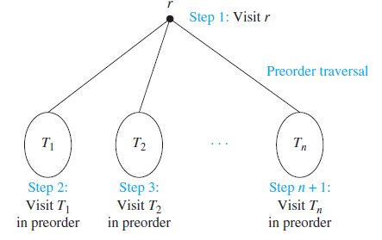

Preorder Traversal-Continue

Slide 22
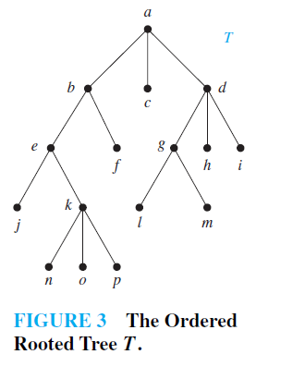
Example
In which order does a preorder traversal visit the vertices in the ordered rooted tree T shown in Figure 3?

Slide 23
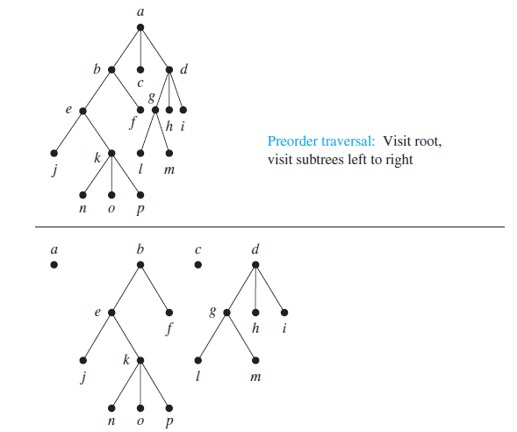
Solution

Slide 24
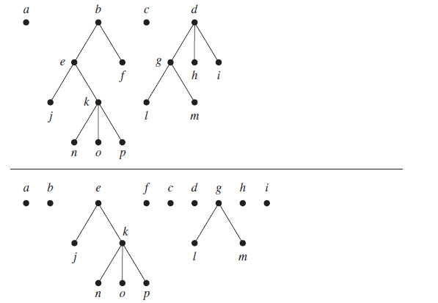
Continue

Slide 25
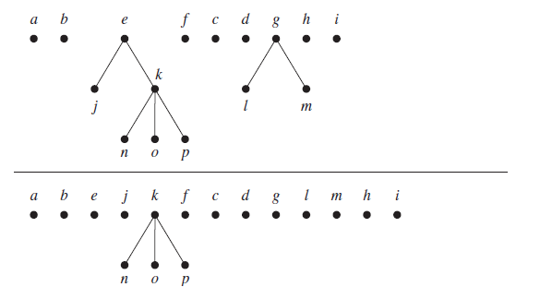
Continue

Slide 26
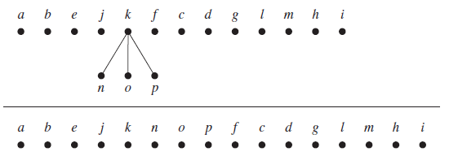
Continue

Slide 27
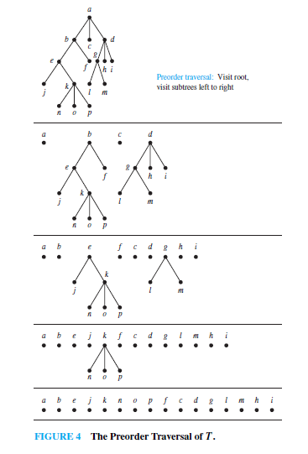
The Preorder Traversal of T

Slide 28
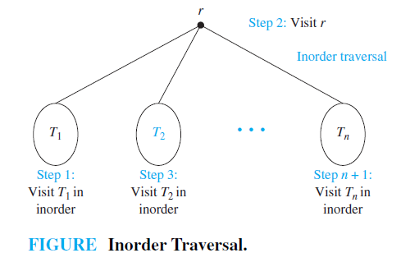
Inorder Traversal
Let T be an ordered rooted tree with root r. If T consists only of r, then r is the inorder traversal of T . Otherwise, suppose that T₁, T₂, . . . , T_{n} are the subtrees at r from left to right. The inorder traversal begins by traversing T₁ in inorder, then visiting r. It continues by traversing T₂ in inorder, then T₃ in inorder, . . . , and finally T_{n} in inorder.

Slide 29
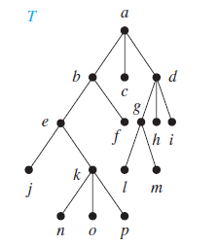
Example
In which order does an inorder traversal visit the vertices of the ordered rooted tree T in Figure 3?

Slide 30
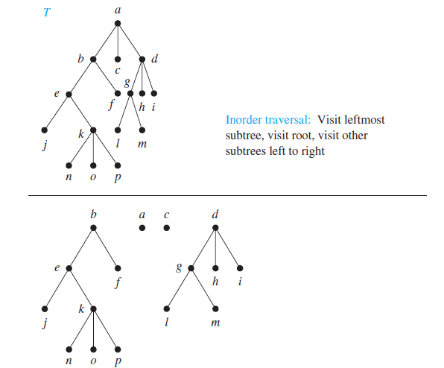
Solution

Slide 31
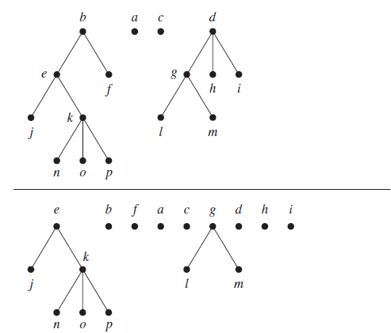
Solution-Continue

Slide 32
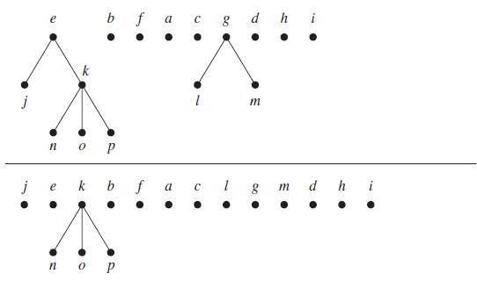
Solution-Continue

Slide 33
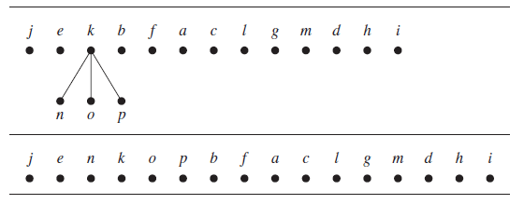
Solution-Continue

Slide 34
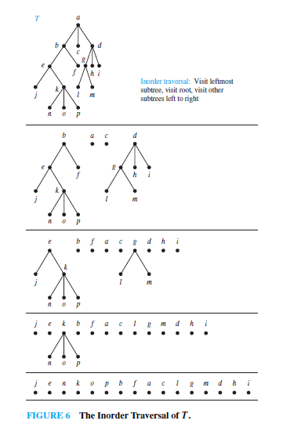
The inorder Traversal of T

Slide 35
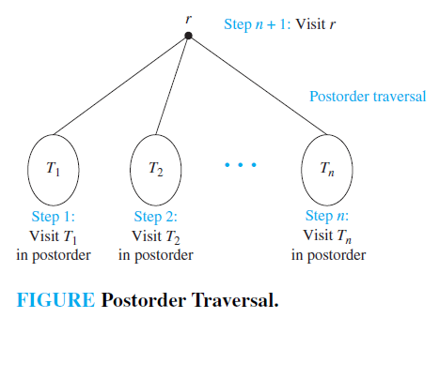
Postorder traversal
Let T be an ordered rooted tree with root r. If T consists only of r, then r is the postorder traversal of T . Otherwise, suppose that T₁, T₂, . . . , T_{n} are the subtrees at r from left to right. The postorder traversal begins by traversing T₁ in postorder, then T₂ in postorder, . . . , then T_{n} in postorder, and ends by visiting r.

Slide 36
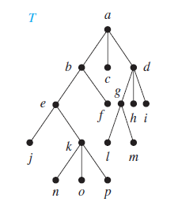
Example
In which order does a postorder traversal visit the vertices of the ordered rooted tree T shown in Figure 3?

Slide 37
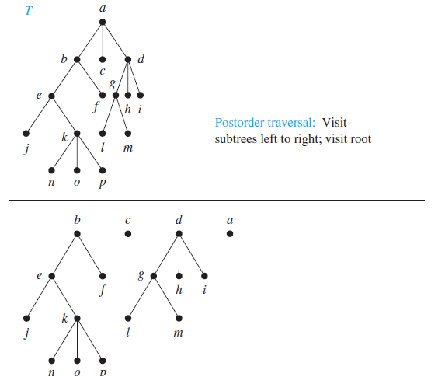
Solution

Slide 38
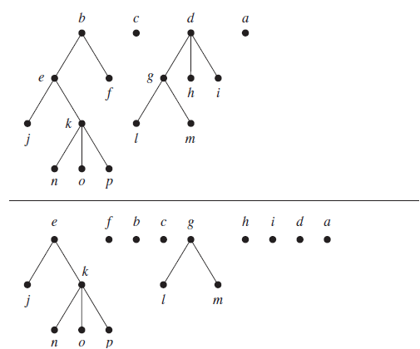
Solution-Continue

Slide 39
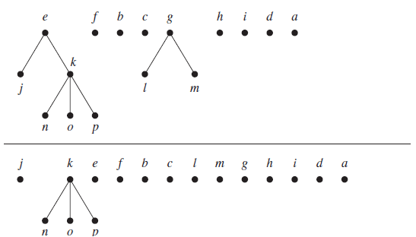
Solution-Continue

Slide 40
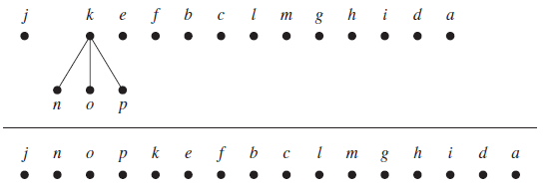
Solution-Continue

Slide 41
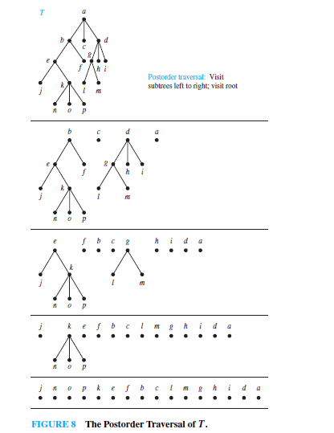
Postorder Traversal of T

